Slide 1
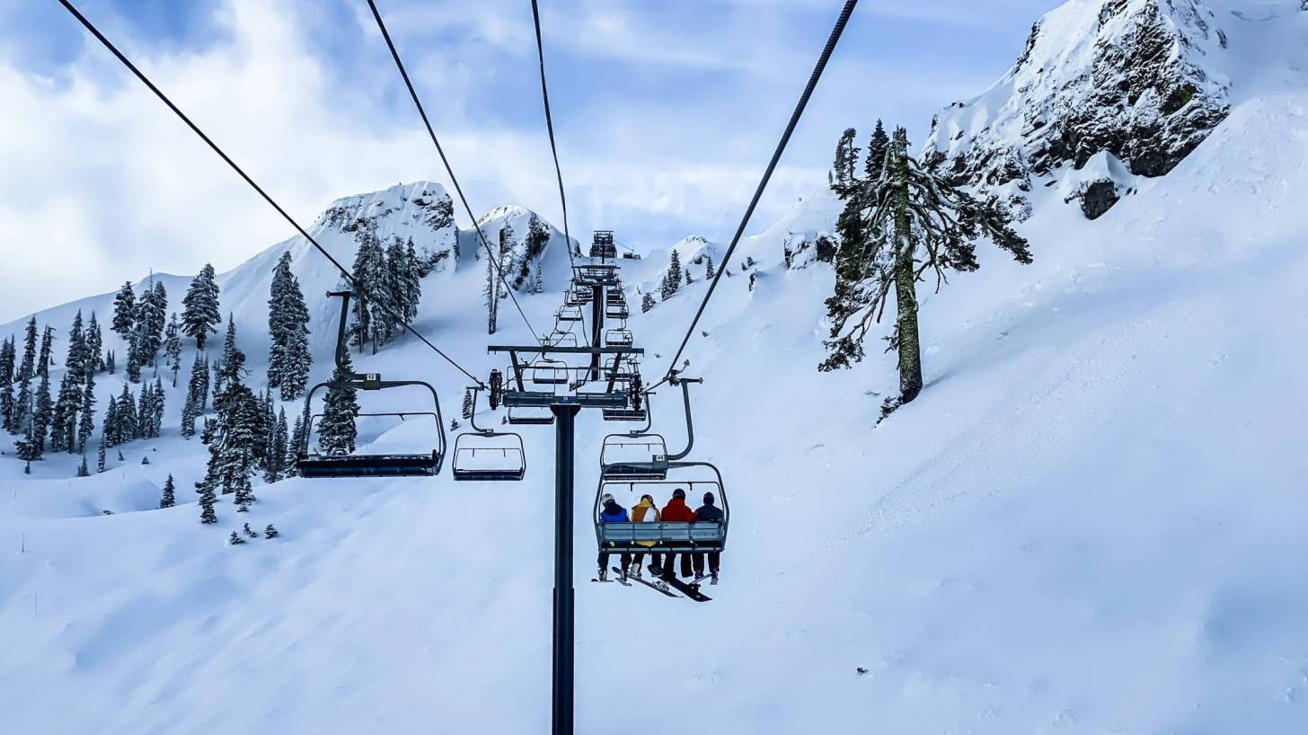
Big Mountain Resort (BMR)
Analysis Overview and Recommendation
Prepared by: Mark Clampitt
September, 2021

Slide 2
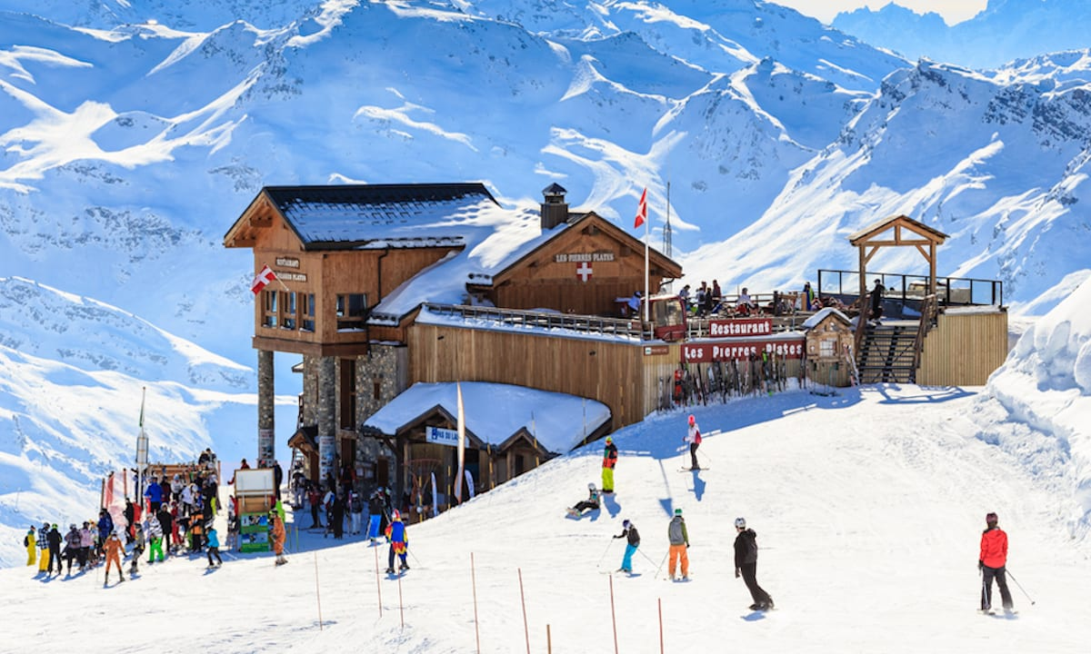
Agenda
Objective
Proposed Changes Results and Recommendation
Model Results and Analysis
Summary and Conclusion

Slide 3

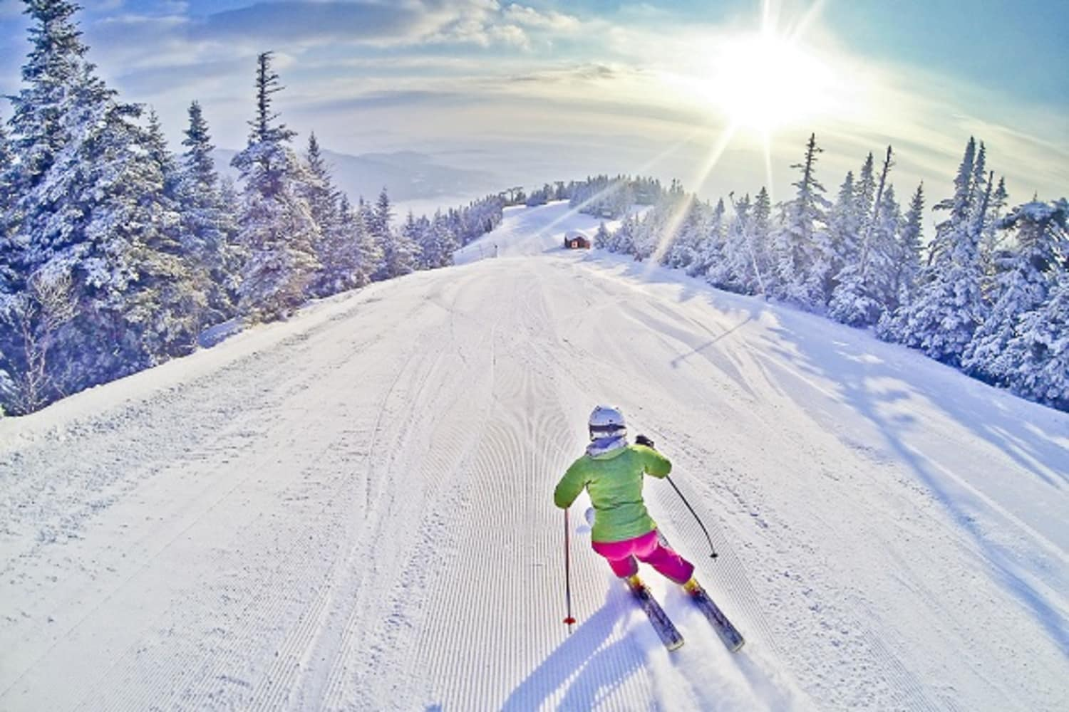
Objectives
Determine what Big Mountain Resort should charge for ticket prices based on the market and facilities offered.
Determine what changes should Big Mountain Resort consider to either:
reduce operational costs while maintaining the value of the ticket price
or add additional services to justify increasing the ticket price

Slide 4
Proposed Changes Results and Recommendation
Proposed Changes Results:
Closing up to 10 runs – Results showed that closing 3-5 would minimally impact ticket price by -$0.51. Closing any more than 5 doubles the expected impact on price.
Increase by 1 run, increase vertical drop by 150 feet, and add 1 additional lift – Results in an increased price of $1.51 (on top of the current predicted price of $96, give or take $10).
Same scenario as 2 with the addition of increasing Snow Making by 2 acres - Results did not yield a higher predicted price increase than in #2.
Increase the longest run by 0.2 mile, additional snow making coverage of 4 acres – Results showed no impact on price.
Recommendation:
Option 2 - Implementing these changes would give BMR the best opportunity to justify increasing prices somewhere between $87-$107.

Slide 5
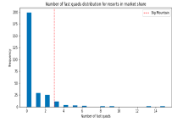
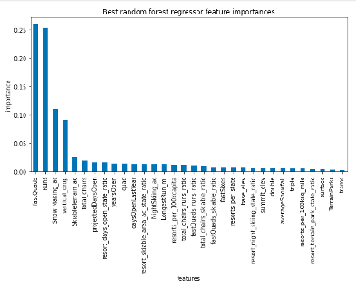
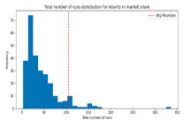
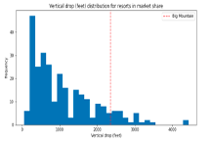
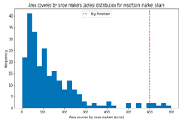
Modeling Used in Analysis
Best Random Forest Regressor Model was used in the analysis to predict price based on the facilities features of each resort. The image above (center) shows each features impact on price. Based on the facilities data used in the dataset, the model proved to predict price within $9 of the actual price. BMR’s price was predicted at $96. The top four features were fast quads, total runs, snow making acres, and vertical drop. The graphs to the right and left show how BMR compares to resorts in those categories on a national scale.

Slide 6
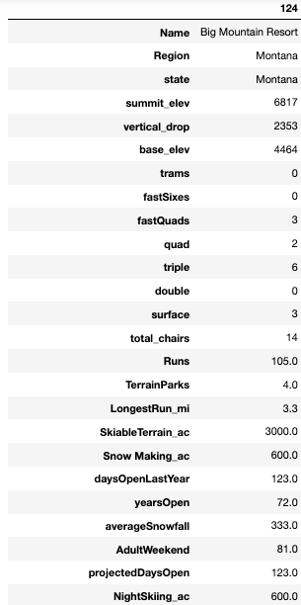
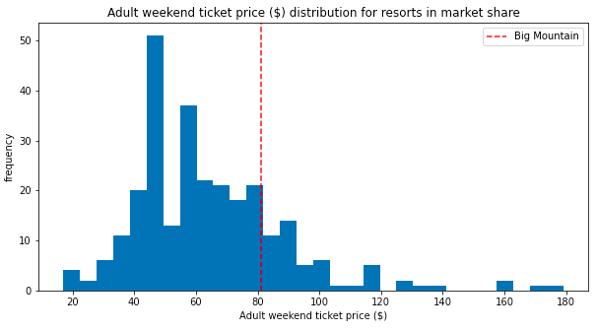

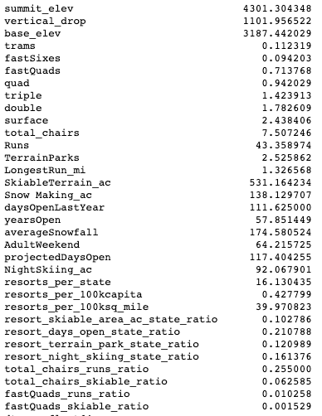
Summary and Conclusion
Other Resorts (Mean)
Suggested new price bracket range
= Areas that BMR outperforms average of other resorts
This analysis supports the suspicions that BMR should be charging more based on how their facilities compare with other resorts offerings. As shown on the right, BMR in most cases far ourperforms every feature compared to the averages of the other resorts (with the exception of trams, fastSixes, and double). With the recommended changes, BMR will be able to justifiably move into the price bracket more suited to their offerings (between $87-$107).

Slide 7
Analysis Overview and Recommendation
Prepared by: Mark Clampitt
September, 2021

